Slide 1
Reimbursables, Expenditure Transfers, and Other Fun Stuff
Dial in (Main): (404) 397-1596
Attendee Access Code: 199-891-3274
Slides available on SharePoint:
See link in Q&A
Allen Dunlow, Director Finance, ORD
Kari Points, Director Research Operations Iowa City
Antonio Laracuente, Director Research Operations Atlanta
March 25, 2021

Slide 2
Agenda
PMO Update
Dunlow Musings
Expenditure Transfer
  Internal to Research
  External to Research
Reimbursables
  Foundation (X2)
  University (R1)
  Interagency Agreements

Slide 3
Redistribution of Funds – Guidance
Evaluate your Current Year balances for all studies and if you find a need to return money that you will not obligate this fiscal year, consider this guidance:
  All services are encouraging submission of PMOs for redistribution of funds
  Submit as soon as possible
    RR&D March 31 send directly to Tiffany.Asqueri@VA.gov
    BLR&D May 31 send to VHABLRD-CSRD@VA.GOV
    CSR&D Preferred March 31 send to VHABLRD-CSRD@VA.GOV
    HSR&D April 15 send to VHACOHSSRDPM@VA.GOV
  If you want to request a no cost extension at the end, then you would check both the NCE and the redistribution and provide the amount of funding to pull from this year.
  If you want to redistribute to next year or the following AND not extend the study, then just ask for a redistribution.
  This ONLY applies to redistribution of existing funds. As described in the FAQs on the COVID share point, all other requests related to cost/no cost extensions resulting from the pandemic will only be reviewed during the last year of the award. The only exception to this timing is in the case of redistributions
  The Primary site should submit the PMO for multi-site studies

Slide 4
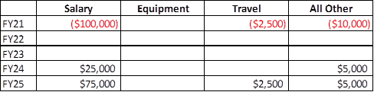
Redistribution of Funds – Project Modification
Keep it simple. A short justification and the bottom-line redistribution amounts from FY 21 to future FY will suffice.
It is helpful but not necessary to have the amounts to be withdrawn by budget category (i.e., salary, travel, equipment, all other) and in what FY(s) to return the funds by budget category. (Required only for RR&D)

Slide 5
Dunlow Musing
Current year New expenditure reporting module (RAFT)
Prior year balances
X2 fund balances (transfer them)
R1 fund balances (transfer them)

Slide 6
Expenditure Transfers (EW)
Basic premise is to move the cost from one Control Point to another.
  Could be across programs, fiscal years or appropriations
High number of them are for salary costs but there are cases for services and even purchase obligations
Dependent on your station budget and accounting
  Salary transfers are usually handled by Budget
  Purchases and other types of orders are usually handled by accounting

Slide 7
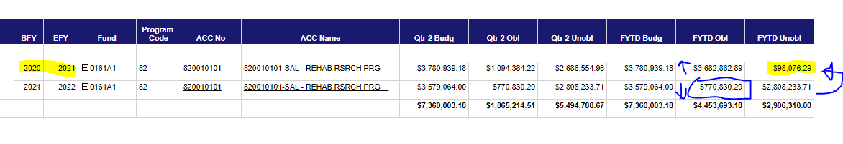
Examples
Salary
  You have a balance in Prior Year funds
  You have incurred costs in current year funds that you wish to transfer the expense to prior year funds
    Assuming you have a zero or positive balance in all other
    Request to EW From 005 to 005PY $98,076.29 for salaries incurred in PP2
    Provide a listing of the employees and the cost to research
    Source – VSSC > Finance > Budget Distribution > Status of Allowance

Slide 8
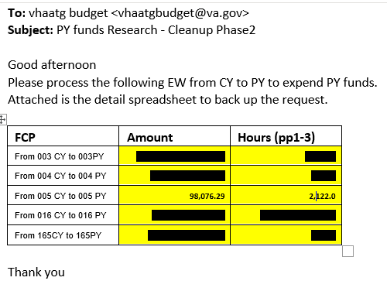
Example – Request to Fiscal

Slide 9
Example
Cost will move from Current Year to Prior
  Balance in FYTD Unobligated Prior Year will go to Zero
  Balance in FYTD Unobligated Current Year will increase by $98,076.29
  Source – VSSC > Finance > FMS Expenditures…..> F20D – Daily Activity…..

Slide 10
EW for non-salary
Basically, the same but you would provide Accounting with the obligation number, BOC code and amount
The obligation must be expensed (paid out not just obligated)
Would go from all other to all other FCPs

Slide 11
Expenditure Transfers – Medical Center Salaries
Expenditure Transfers may occur between appropriations for salary costs when you have clinicians on Career Development Awards or individuals working on both research and special purpose (Med Ctr) projects.
Individuals should initially be hired under the appropriation they are conducting most of their work. Examples:
  CDA – 6/8ths Research and 1/8th or 2/8th MC. Hire under research.
  Special Purpose – 75% Med Ctr and 25% Research. Hire under Med Ctr. Note: Hiring individuals under the Med Ctr will impact the FTE of Med Ctr.

Slide 12
Expenditure Transfers – Medical Center Salaries (cont)
Ensure you have a mechanism established for tracking cost transfers and complete these throughout the year.
Do not wait until the end of the fiscal year to request as it does have an impact on your overall balances. Remember: ORD is unable to do expenditure projections throughout the year if you wait and do a large one-time transfer at end of year. It impacts the execution of the appropriation.
Documentation – Memorandum of Understanding (MOU) between Med Ctr and Research.

Slide 13
Expenditure Transfers – Facility Services
Expenditure Transfers should occur between Med Ctr and Research when a service is being provided to Research.
  Examples:
    Pharmacy
    Radiology
    Laboratory
These types of transfers should be done through an Intra-Agency Agreement (VA Form 2269). The IAA allows for the reimbursement of funds for the expenses incurred by the Med Ctr department. An amount is estimated for the fiscal year for each service/department. The IAA is signed by the department (Pharmacy, Radiology, etc.), Research, and Fiscal.
A 1358 is then set-up for the fiscal year based on the estimated amount. As services are provided, the Med Ctr is reimbursed through the 1358.

Slide 14
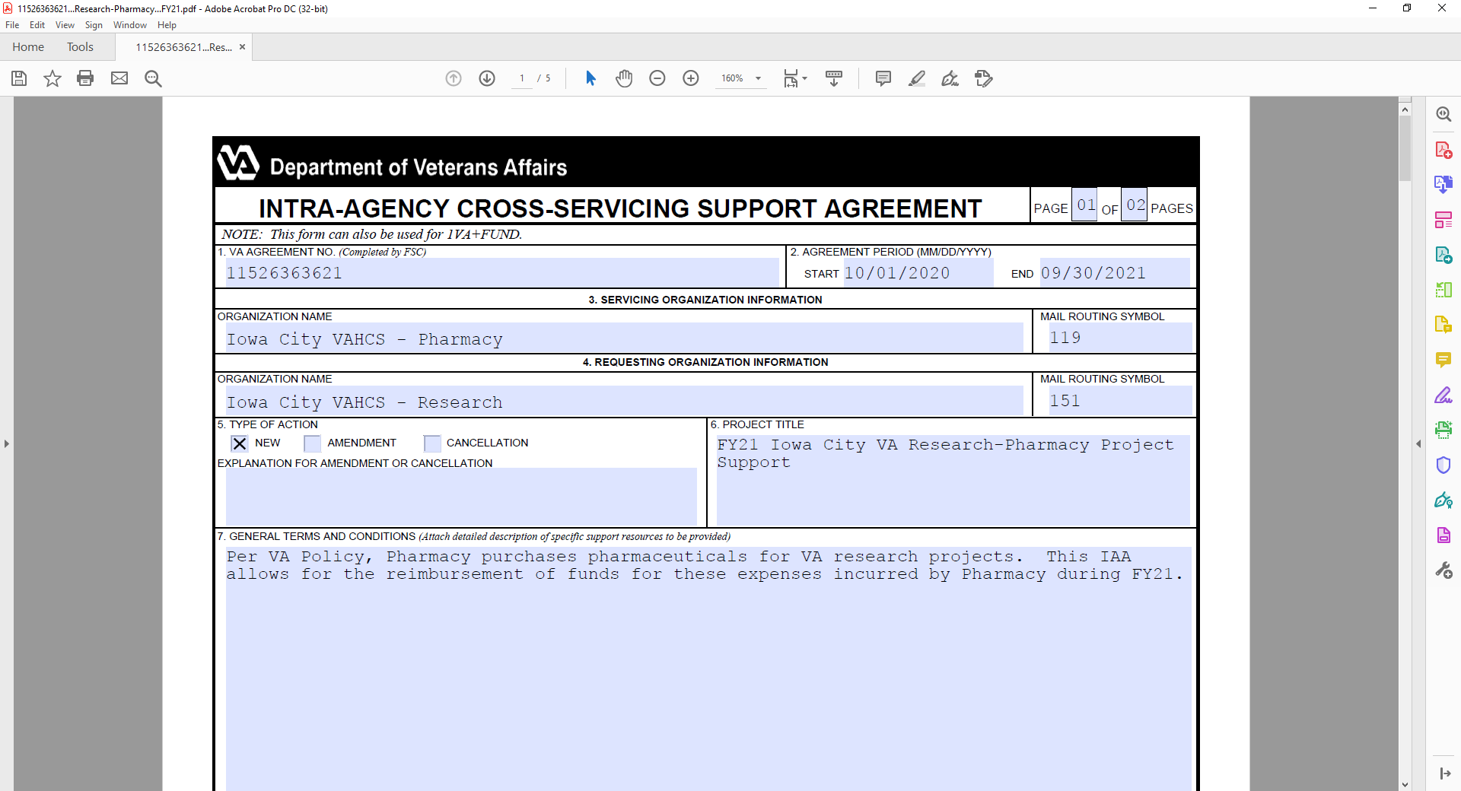

Slide 15
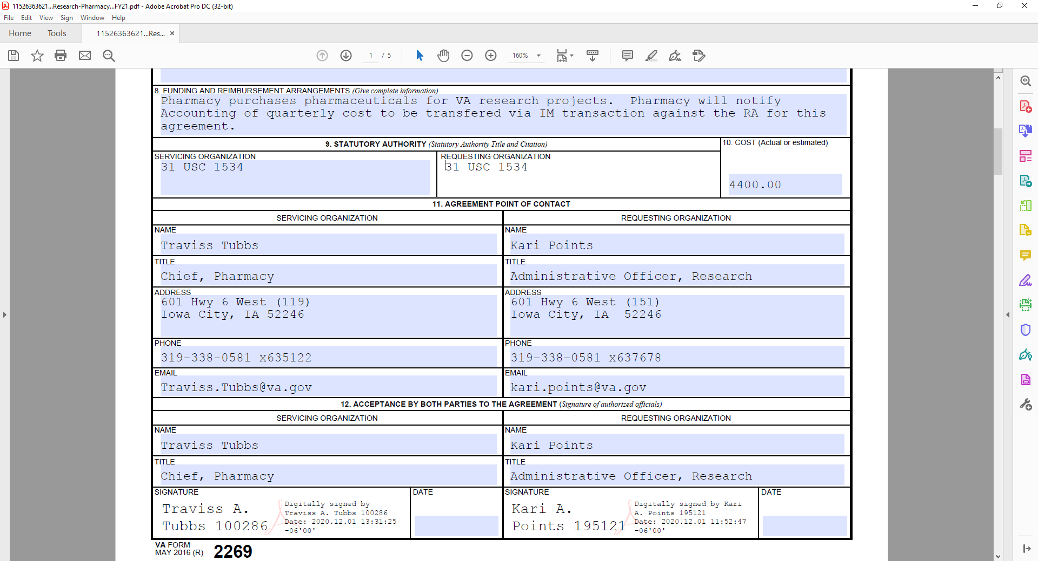

Slide 16
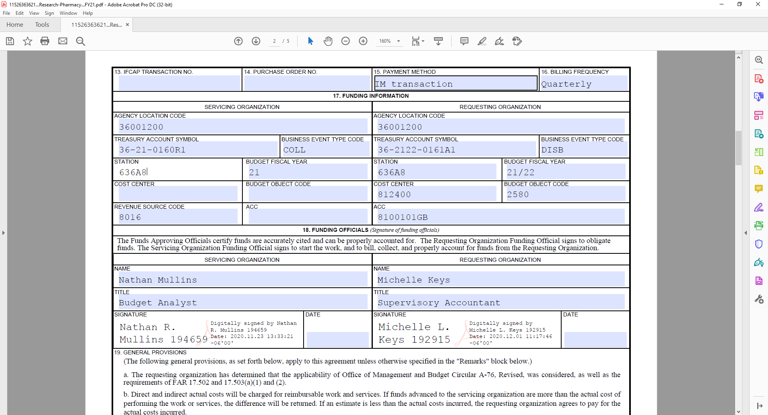

Slide 17
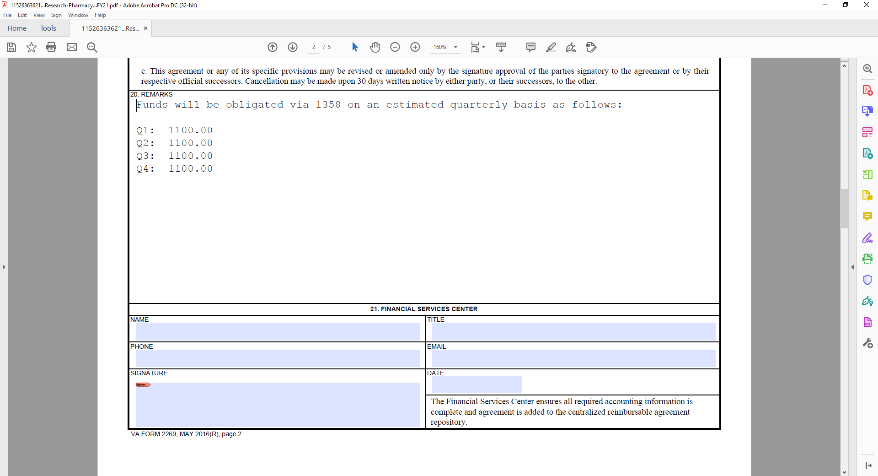

Slide 18
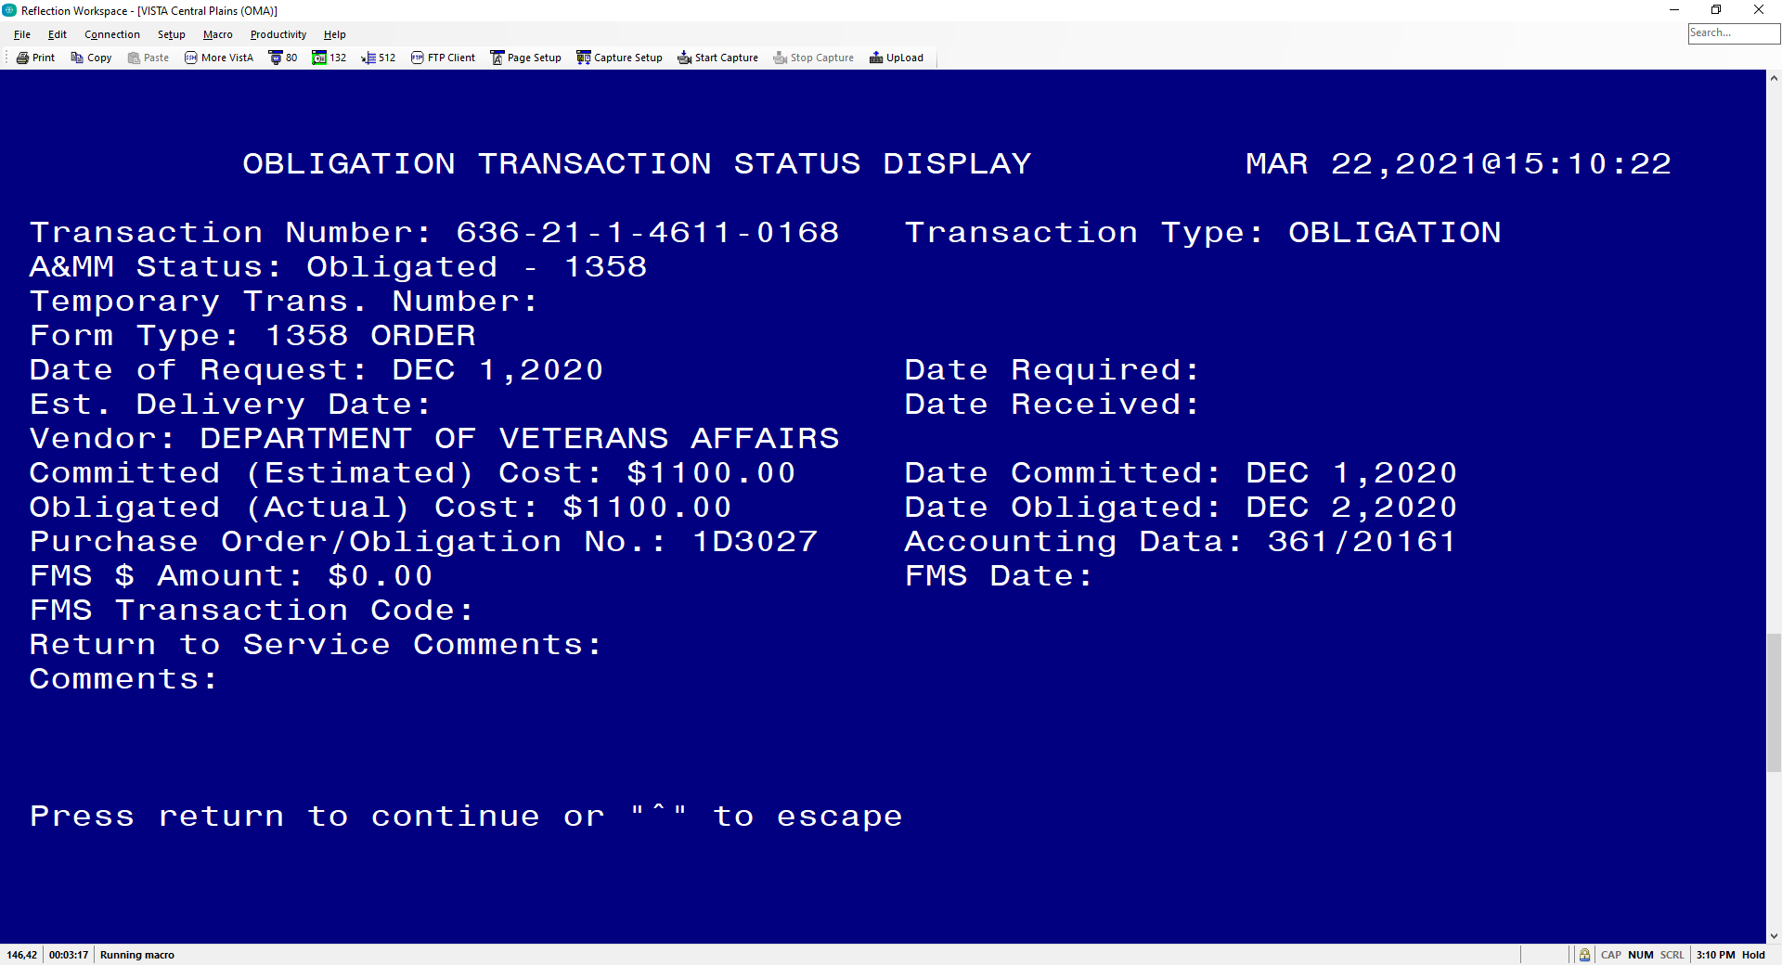

Slide 19
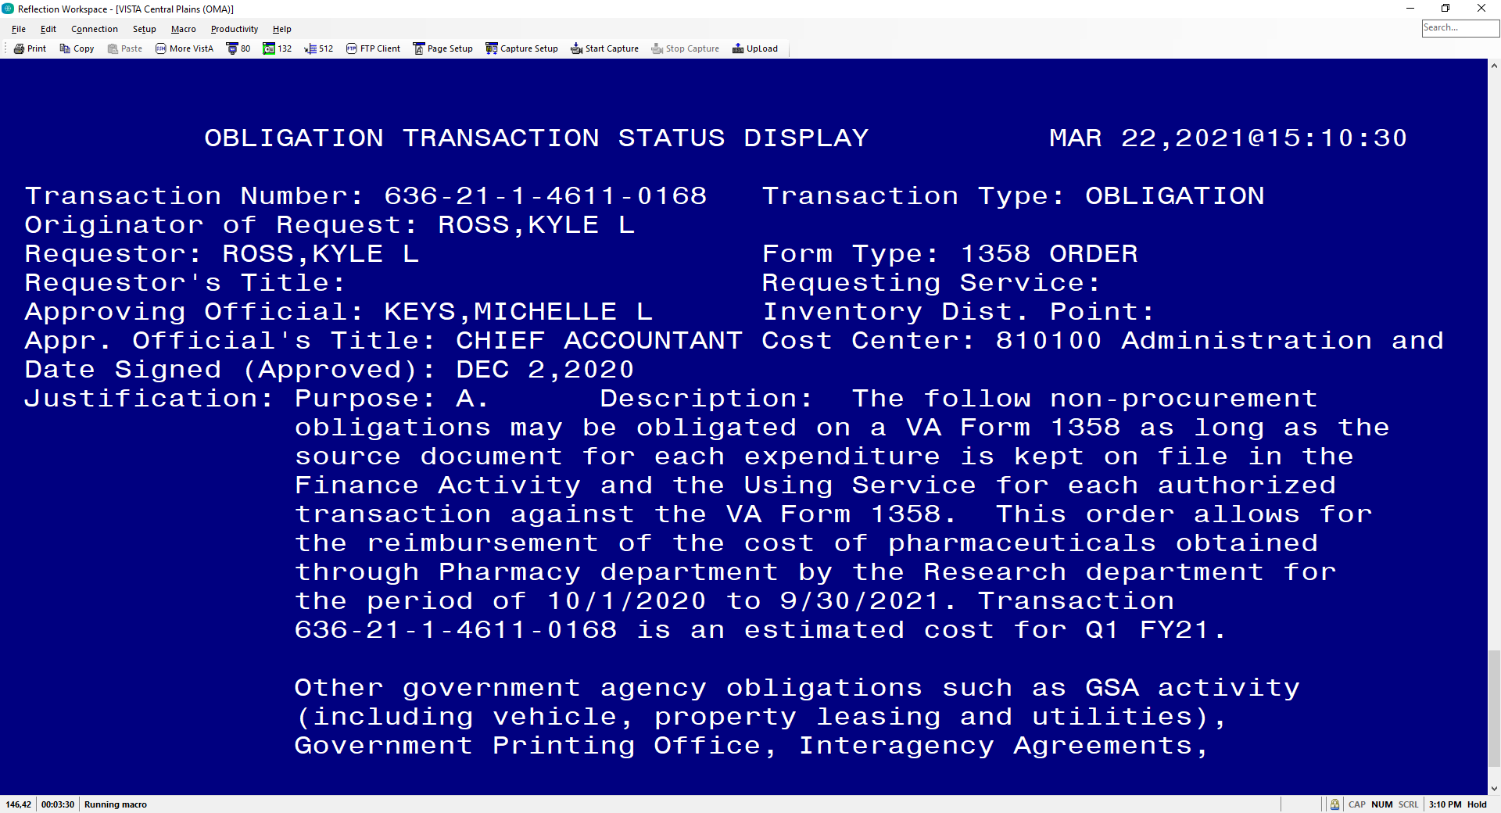

Slide 20
Billing
Bills fall under the reimbursable category
It is inappropriate to bill against and deposit to the General Post Fund
Bills should be collected against the year the cost was incurred
Documented evidence for the bill is required by voucher audit

Slide 21
Reimbursables
Foundation
Other non-Federal (universities)
Interagency Agreement (Federal Agencies)

Slide 22
Working with the Foundations
When reimbursing research use 0161X2
All other NPC Reimbursements should go back directly to the other appropriation R1 accounts:
  the medical care appropriation (0160R1)
Required backup documentation
  MOU outlining the need for reimbursement and the authority will be required when auditing bill
Fund control point should be established in the 0161X2 appropriation as no year funding

Slide 23
Simple process for Billing
Determine if this is salary or product reimbursement.
Create an MOU with the entity: NPC or Affiliate in most cases.
If Affiliate have the person requesting the MOU provide an administrative contact at Affiliate to route the MOU
    Get signatures at affiliate by sending to the admin. Then route internally
  If NPC contact NPC staff to complete. Once MOU is in place give it an MOU number if Fiscal has not already
Create the bill in the VISTA billing system
  Make sure you have access to the med care 0161X2 FCP so you can create the bill
  Follow example provided on how create the bill
  In description section enter the PI name, the project and the account at entity. You can also enter where to send the payment so you can take to agent cashier.
  Approve Bill
  Once voucher audit approves the bill print it and send it to the admin contact or FAVER for payment. DO NOT WAIT for Fiscal to issue the letter of indebtedness. That takes too long.
  Get the check and take to agent cashier with copy of bill
Getting the reimbursement credited. Usually, it takes 30 to 60 days for VACO to send the money.
Once sent you need to request an expenditure transfer from the FCP where cost were incurred to 0161X2 or 0160R1 FCP where the money is. This reduces your obligations, essentially giving you the money back.

Slide 24
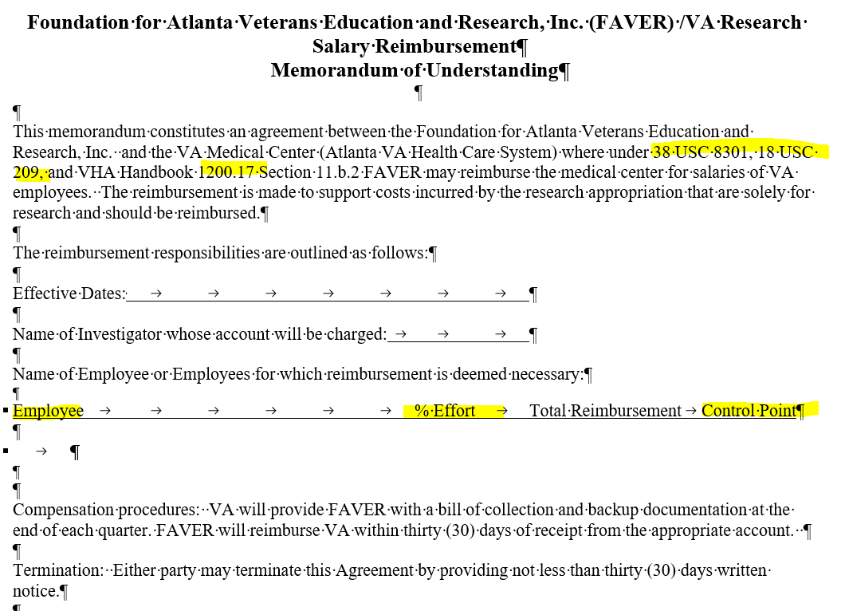
Example of MOU

Slide 25
Setting up the Bill
In VISTA
Select Control Point Official's Menu Option: billing
Select Billing Option: new Bill (Enter)
SITE: ATLANTA VAMC// GA VAMC 508
BILL NO. : n ... Bill Number '508 -K######' assigned
FORM TYPE: 1114 (vendor)
CATEGORY: VENDOR V – (vendor)
CONTROL POINT: 280 (this is the X2 FCP)

Slide 26
Setting up the bill
DATE BILL PREPARED: enter date
VOUCHER NUMBER:
BILLING AGENCY: DVA Medical Center
BILLING AGENCY DEBTOR (PAYER): 8049 for FAVER (Varies by Station)

Slide 27
Setting up the bill
Select DATE OF CHARGES: t JUL 08, 2009 DESCRIPTION OF CHARGES:
No existing text Edit? NO// y YES
  (Reimbursement) for work performed by X for the period of date to date. Per the Memorandums of Understanding between the VA NPC and the VA Medical Center where VA NPC may reimburse the VA Medical Center for salaries of VA employees. The reimbursement is made to support costs incurred in support of the project X under the direction of PI Name .
MOU number:
    Fund 0161X2
    FCP (Enter the Reimbursable FCP)
    BFY: Enter the Fiscal Year
    BOC 1031

Slide 28
Setting up the bill
QUANTITY (UNITS): Enter number of units (for effort use 1)
UNIT COST: enter amount to reimburse
UNIT: for effort enter JB, for Units do a ? and use appropriate
TOTAL AMOUNT: 19672// (No Editing hit enter) Select DATE OF CHARGES: (hit enter
Select FISCAL YEAR: hit enter
FY ORIGINAL AMOUNT: 19672// hit enter
Select FISCAL YEAR: hit enter
Display/Print Bill:? Yes// (Yes)
DEVICE: HOME // HOME Right Margin: 80//

Slide 29
What happens next
Bill is approved by FCP Approving Official
Accounting Reviews the bill and may ask questions, send back or approve
  Question may include:
    What BFY is the bill to be collected in? Use the year that the expense was made
    What is the revenue code? Usually, it will be one of the following 3
      8000 – Non medical reimbursements
      8004 - ANCILLARY MED SVC, MED RES
      8020 - FED INTERAGENCY AGR - MED RES
Accounting approves the bill and the clock starts ticking
Deposit check through Agent Cashier
TDA is then processed once the collection is completed

Slide 30
University Bills (0161R1)
Bills of Collection occur to the University when the research appropriation should be reimbursed by the University for costs incurred.
Examples include salary, animal per diems, core services etc.
To initiate a bill of collection, you must have the billing menu in ViSTA. The entity being billed must be vendorized in the VA system.
If you are billing to the University, be sure to bill to your 0161R1 fund control point.
All reimbursements from your affiliate should come through the 0161R1 fund. These are sent through a TDA each month. You should not be depositing checks from the affiliate directly into a fund control point.

Slide 31
University Bills (0161R1) – cont.
Once reimbursements are deposited into the 0161R1 fund, you need to request a cost transfer to move those funds into the FCP where the expenses originally occurred. This should be done throughout the fiscal year so you are not doing one cost transfer at the end.
Documentation – An MOU agreement with your affiliate should be in place for the expenses that you are billing.

Slide 32
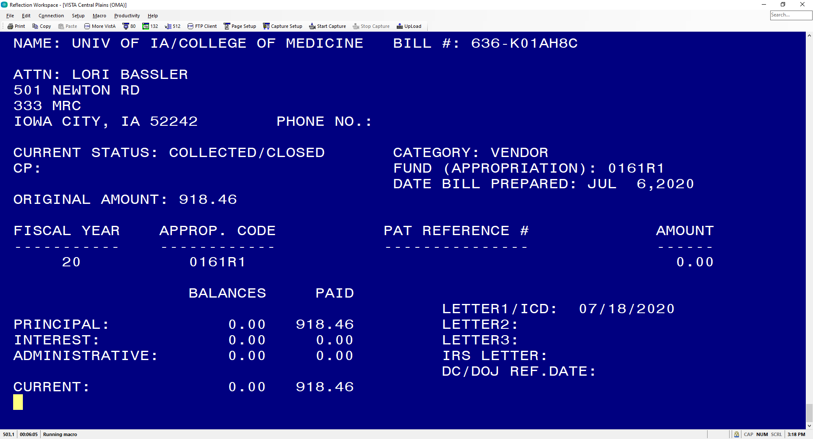

Slide 33
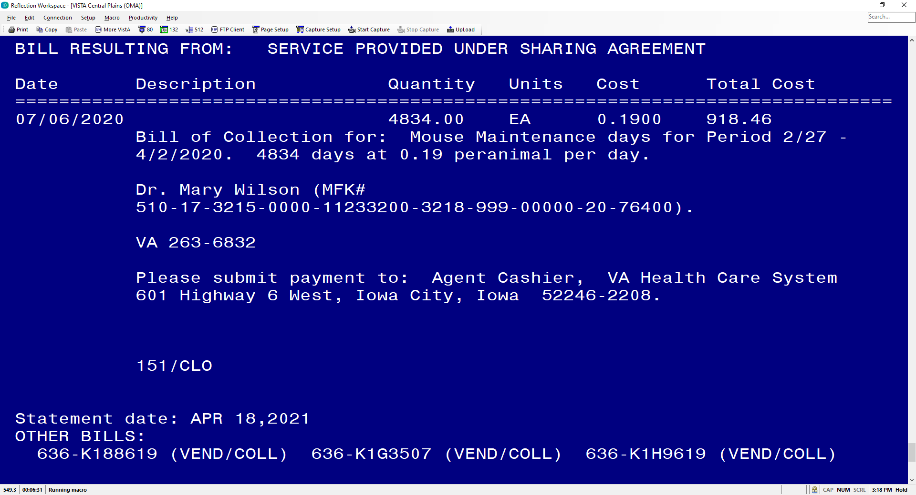

Slide 34
Interagency Agreements
Used for collaborative research with Federal Institutions
Requires Treasury Form 7600 which can be multi year and delineates if funds will be advanced
  General Terms & Conditions (form 7600A) and Order Requirements (form 7600B). Updated September 2020
Signatories
  7600A is signed by the Agency Official, so the MCD.
  7600B is signed by both the MCD and ORD/Director of Finance.
Requires loading into the repository
Billings done by the facility
Accounting will create and IPAC to move the money from agency to VA

Slide 35
Billing
Similar process to bills above
When entering need to have the agency vendorized
Use Form Type 1081 (Federal Agencies – Reimbursable)
Accounting will require copy of the signed 7600
TDA will be sent by ORD

Slide 36
Resources
Reimbursable Policies - Financial Management System Services (va.gov)
Finance Alerts
FSC Trainings

Slide 37
Questions??

Slide 38
Availability of Recording
A recording of this session and the associated handouts will be available on ORPP&E’s Education and Training website approximately one-week post-webinar
An archive of all ORPP&E-hosted webinars can be found here: https://www.research.va.gov/programs/orppe/education/webinars/archives.cfm

